Slide 1
A/B Testing Analysis
Evaluating whether a new webpage increased customer conversion rates
Madeline Galbraith
SQL • Python • Statistical Analysis • Data Visualization

Slide 2
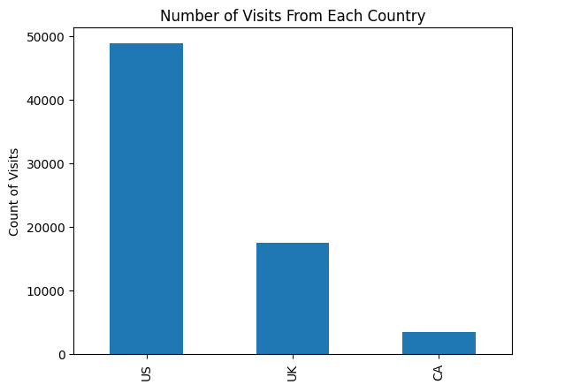
Business Problem
A company launched a redesigned webpage and wanted to determine whether it increased customer conversion rates enough to justify replacing the existing page.
Objective:
Compare treatment vs. control
Determine statistical significance
Recommend whether to deploy the new page

Slide 3
Conversion Rates by Country
US
UK
CA
Control 0.107314 0.101649 0.094474
Treatment 0.157769 0.148698 0.154017

Slide 4
A/B Test Executive Summary
The treatment group had a higher conversion rate than the control group in all three countries. The United States had the highest conversion rates for both the control and treatment groups. Although the conversion rates differed slightly between countries, the logistic regression analysis showed that country was not a statistically significant predictor of conversion. This suggests the treatment page had a greater influence on conversions than the user's country.

Slide 5
Experiment Results: The treatment page had a higher conversion rate than the control page. The p-value was below the 0.05 significance level, so the null hypothesis was rejected. This provides statistically significant evidence that the treatment page improved conversions.
v
01
Treatment Conversion Rate
0.155321
02
Control Conversion Rate
0.105254
03
Delta in Treatment vs. Control Conversion Rate
0.050067
04
P-Value
0.000

Slide 6
Business Recommendation
The treatment page demonstrated a statistically significant improvement in conversion rates across the observed population. Country did not significantly influence conversion, indicating the redesigned page can be deployed broadly without regional customization.

Slide 7
Madeline Galbraith
A/B Analysis
Introduction to Data Science - D496
Technical Skills Demonstrated
Python
Pandas
NumPy
Statistical Analysis
Logistic Regression
A/B Testing
Data Cleaning
Data Visualization

